Slide 1
Project Proposal
Team member : Yannan Chen,Yiwei Han,Yu Gui
Team identifier ：C2T5

Slide 2
1
Why we choose
catalogue
2
What we find
3
Where we enhance
4
How we evaluate

Slide 3
1
Why we choose

Slide 4
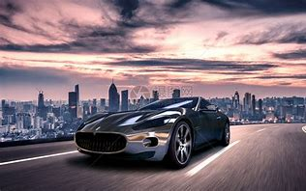
1. Why we choose
Our idea
When we searching for datasets, we found a dataset about cars. It happens that our team members are car fans, and it’s about car evaluation.
Now a days, the automobile industry of China has absorbed the experience of foreign countries and kept innovating. The automobile industry has made remarkable progress. However, automobile quality problems have emerged frequently and become one of the issues of general concern to the public. we think it would be meaningful if we can make evaluation on different cars. So we decided to make a model on Car Evaluation.

Slide 5
2
What we find

Slide 6
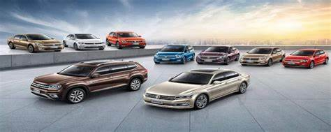
2.What we find
CAR: car acceptability … PRICE: overall price …… buying: buying price …… maint: price of the maintenance … TECH: technical characteristics …… COMFORT: comfort ……… doors: number of doors ……… persons: capacity in terms of persons to carry ……… lug_boot: the size of luggage boot …… safety: estimated safety of the car
Class Values:
unacc, acc, good, vgood
Attributes:
buying: vhigh, high, med, low.
maint: vhigh, high, med, low.
doors: 2, 3, 4, 5more.
persons: 2, 4, more.
lug_boot: small, med, big.
safety: low, med, high.
Cars dataset
In the dataset there are 1728 pieces of data about the quality of 1728 cars and their performance criteria.
The model evaluates cars according to the following concept structure:

Slide 7
3
Where we enhance

Slide 8
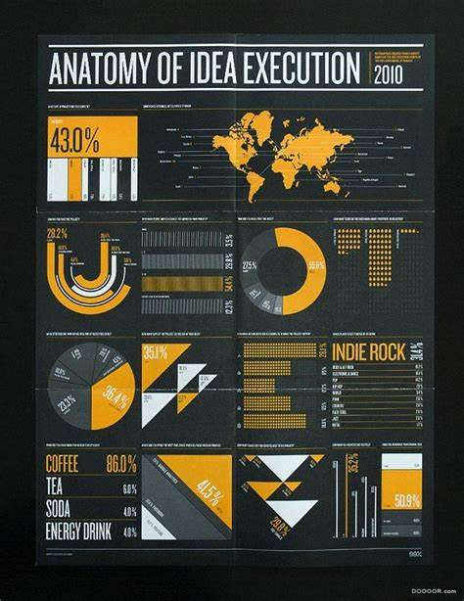
3.Where we enhance
Improvement measure
The Car Evaluation Database contains examples with the structural information removed, i.e., directly relates CAR to the six input attributes: buying, maint, doors, persons, lug_boot, safety. Because of known underlying concept structure, this database may be particularly useful for testing constructive induction and structure discovery methods. We can evaluate it in different ways

Slide 9
4
How we evaluate

Slide 10
4.How we evaluate
We will first quantify the attributes, make them all numbers, then we use Scikit-learn to build a model, our goal is to evaluate a new car by its five attributes.

Slide 11
Thanks for watching

